Slide 1


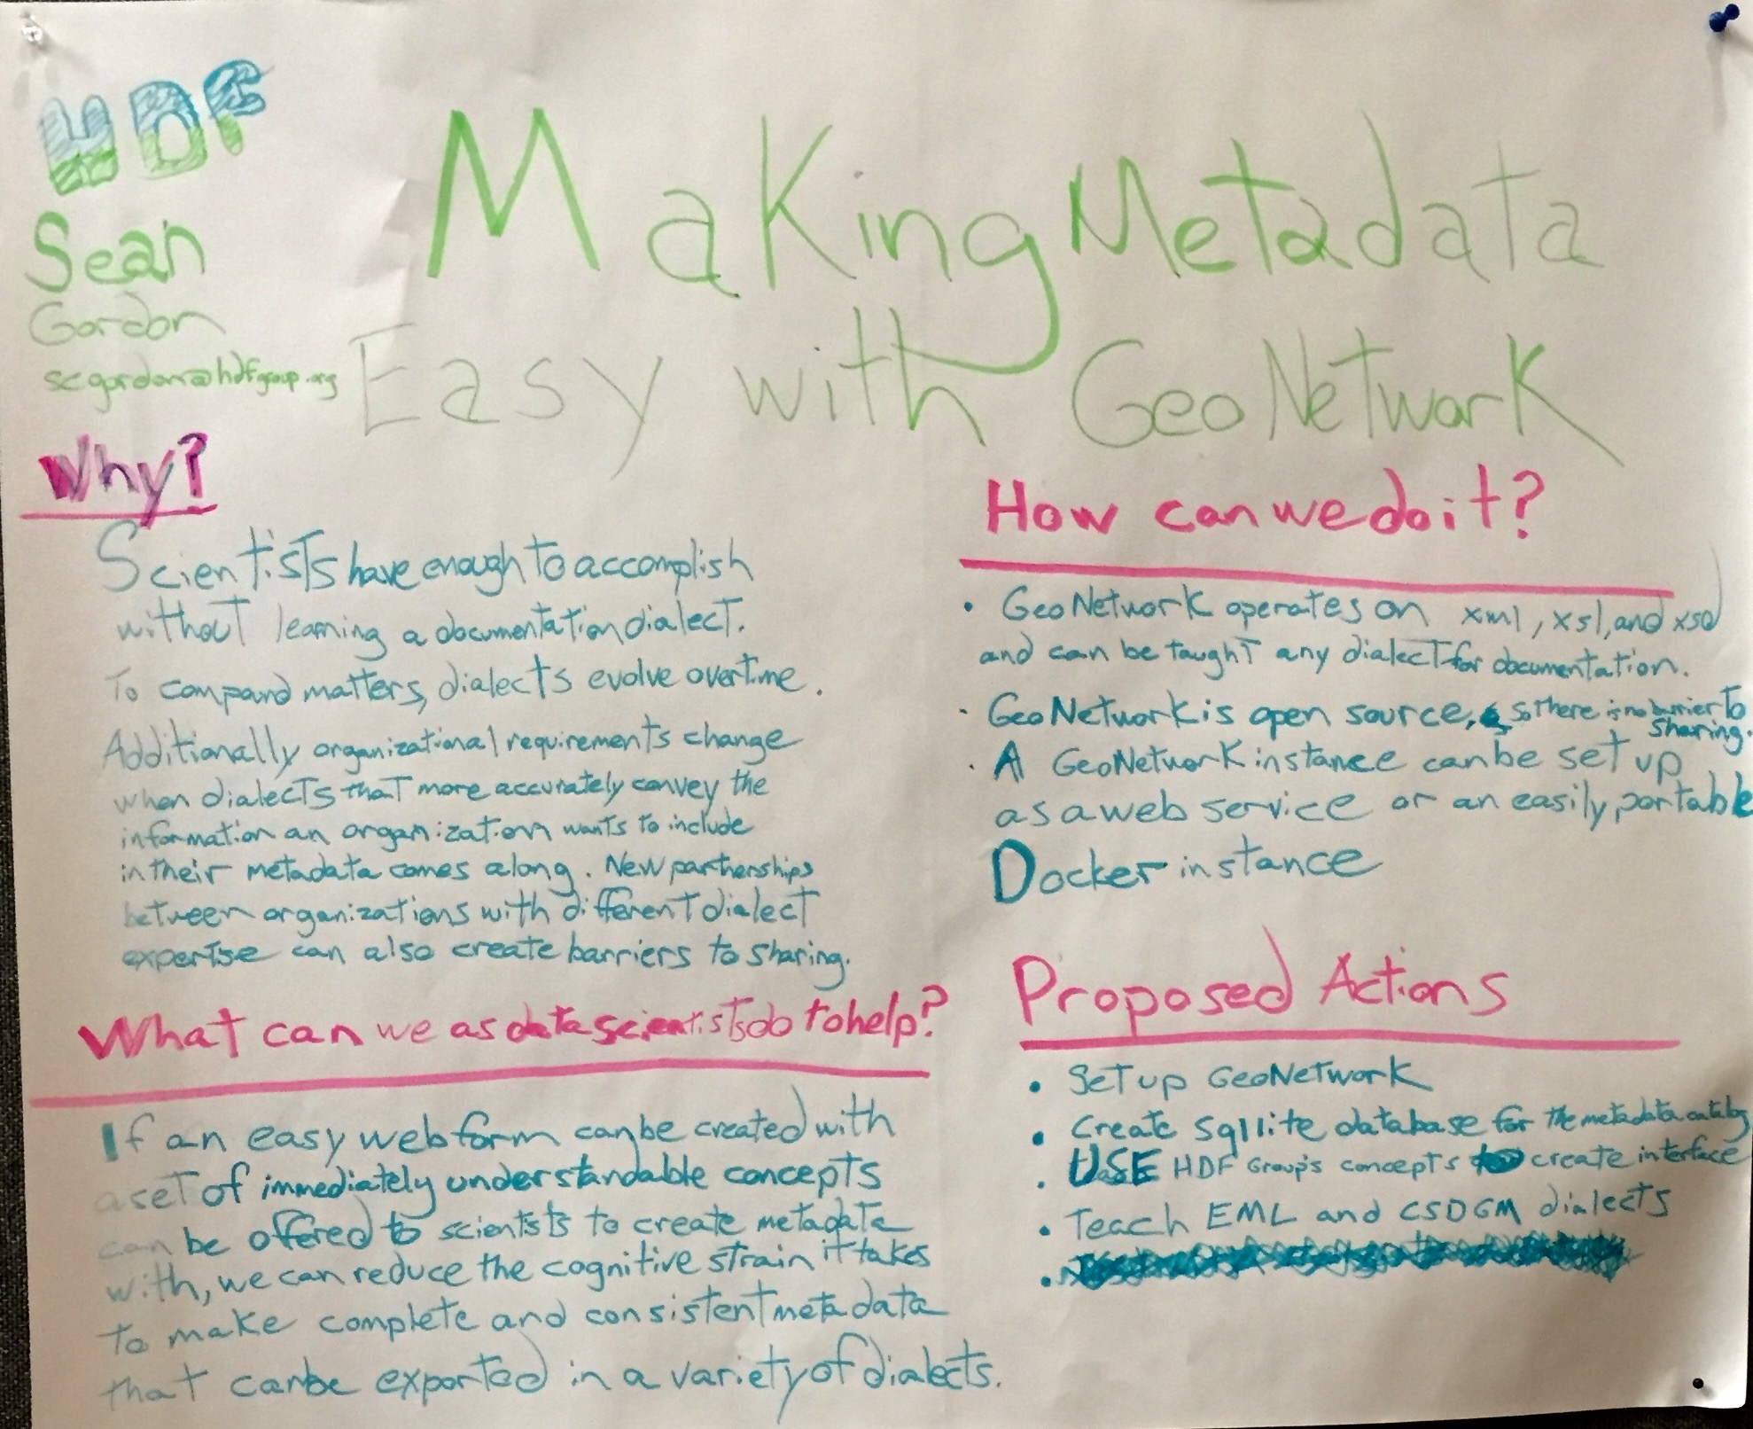







Making Metadata Easy
A Recommendations Based Approach To Documentation using GeoNetwork
Sean Gordon
(scgordon@hdfgroup.org)
Proposal
GeoNetwork is a standards based editor and catalog
Community recommendations facilitate quality metadata
Standards based documentation can be difficult to write well
Simple, editable webforms
Statement Of Work
Tasks
Create GeoNetwork instance.
Explore integration of the Ecological Metadata Language and the Content Standard for Digital Geospatial Metadata dialects and HDF concepts.
Create webform for a recommendation using HDF concepts.
Make and edit metadata.
Deliverables
Poster Presentation at 2017 ESIP Winter Meeting.
https://goo.gl/0SmYSI
https://goo.gl/TBg5zT
Process
Research GeoNetwork
Use Github to build
Focus on integration of recommendations into editor
Implement a schema plugin for ISO 19115-3
Utilize Open Science Framework and Github to document and share research
Toolkit
shrtLink.url
Funding Friday and ESIP are supported by
and 170+ member organizations

Slide 2

Making Metadata Easy
A Recommendations Based Approach To Documentation, Creation, Curation, And Analysis Using Geonetwork
FUNding Friday
Proposal
GeoNetwork is a standards based editor and catalog
Community recommendations facilitate quality metadata
Standards based documentation can be difficult to write well
By combining recommendations and GeoNetwork a webform can created for different recommendations
Statement Of Work
Tasks
Create GeoNetwork instance.
Explore integration of the Ecological Metadata Language and the Content Standard for Digital Geospatial Metadata dialects and HDF concepts.
Create webform for a recommendation using HDF concepts.
Make and edit metadata.
Deliverables
Poster Presentation at 2017 ESIP Winter Meeting.
https://goo.gl/0SmYSI
https://goo.gl/TBg5zT
Process
Research other GeoNetwork instances
Focus on integration of recommendations into editor
Implement a schema plugin for ISO 19115-3
Utilize Open Science Framework and Github to document and share research
Eye with QR code
shrtLink.url
Funding Friday and ESIP is supported by
and 170+ member organizations

